Slide 1
Final Project
B04B01036 林妤真

Slide 2

E. coli
Cd, Pb, Hg
(Zn, Co, Ni)
Transporter

Slide 3

E. coli → Biosensor
Cd, Pb, Hg
(Zn, Co, Ni)
GFP
Heavy
Metal
baseline
0.008 uM
0.04 uM
0.2 uM
1 uM
5 uM
25 uM
125 uM
GFP
GFP

Slide 4
E. coli
Strain 1
Strain 2
Strain 3
Strain 4
Strain 5
Strain 6
Cd
Cd
Cd
Cd
Cd
Cd
Pb
Pb
Pb
Pb
Pb
Pb
Hg
Hg
Hg
Hg
Hg
Hg
Zn
Zn
Zn
Zn
Zn
Zn
Co
Co
Co
Co
Co
Co
Ni
Ni
Ni
Ni
Ni
Ni

Slide 5
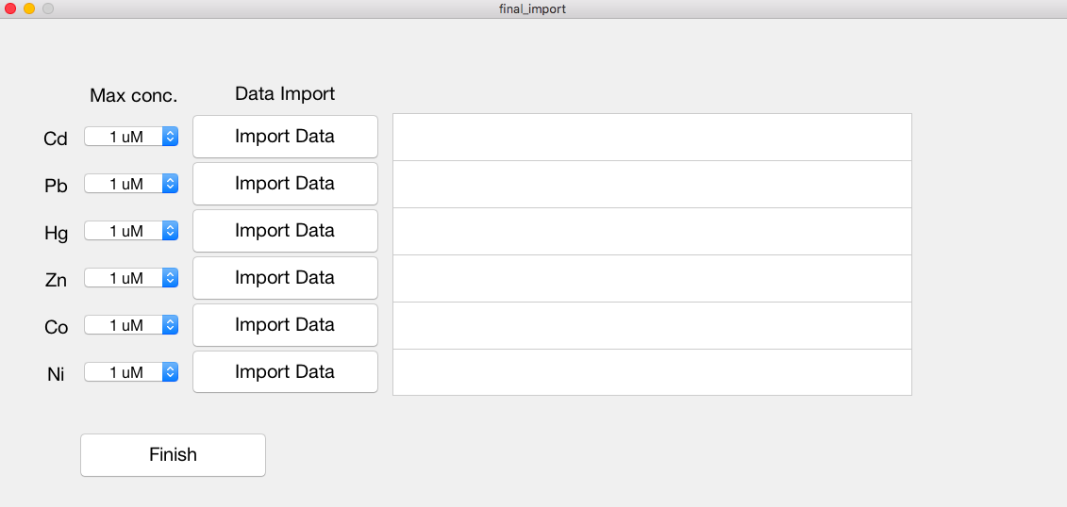
1 xlsx file
Notes:
一個軸只能加一個，但若有sub 可指定要放在哪個sub內
legend creates a legend with descriptive labels for each plotted data series.

Slide 6
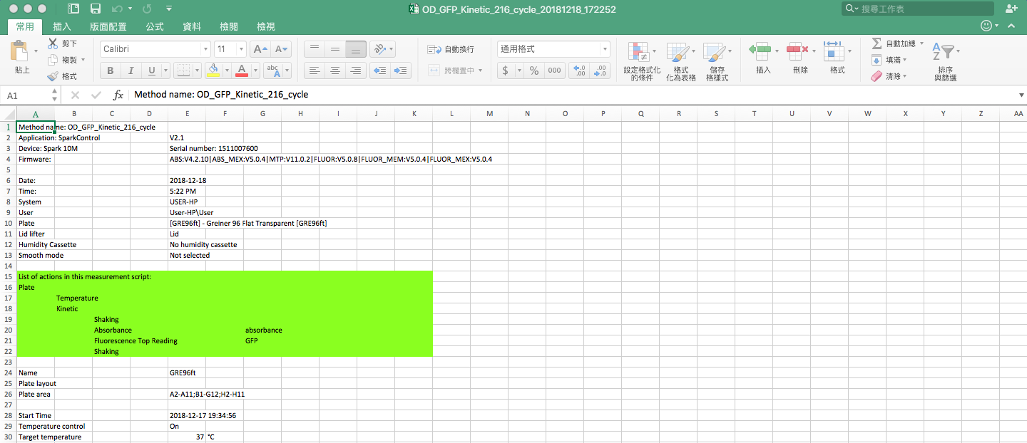
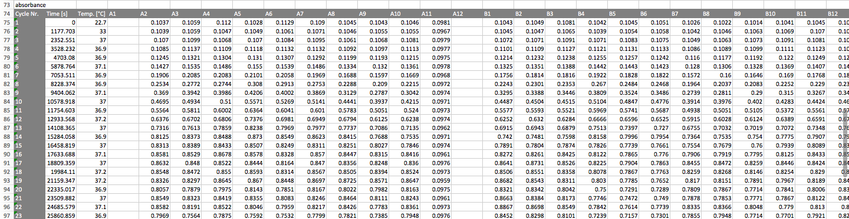
~ 100
~ 100

Slide 7
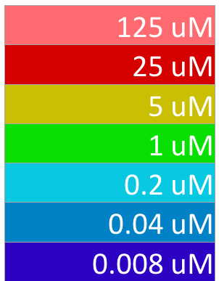
final_import
handles.Conc_Cd.Value =
handles.StrainUnderCd
1
2
3
4
Strain = struct('OD',{ Standard_OD(:,[4:6 15:26 ]),...
Standard_OD(:,[7:9 27:38 ]),...
Standard_OD(:,[10:12 39:50 ]),...
Standard_OD(:,[88:90 51:62 ]),...
Standard_OD(:,[91:93 63:74 ]),...
Standard_OD(:,[94:96 75:86 ]) },...
'GFP',{ Standard_GFP(:,[4:6 15:26 ]),...
Standard_GFP(:,[7:9 27:38 ]),...
Standard_GFP(:,[10:12 39:50 ]),...
Standard_GFP(:,[88:90 51:62 ]),...
Standard_GFP(:,[91:93 63:74 ]),...
Standard_GFP(:,[94:96 75:86 ]) } ,...
'time',{time_OD, time_GFP, 0, 0, 0, 0} );
4
3
2
1
default = zeros( )

Slide 8
final_import
handles.output =
handles.Conc_Cd.Value
handles.Conc_Pb.Value
handles.Conc_Hg.Value
handles.Conc_Zn.Value
handles.Conc_Co.Value
handles.Conc_Ni.Value
handles.StrainUnderCd
handles.StrainUnderPb
handles.StrainUnderHg
handles.StrainUnderZn
handles.StrainUnderCo
handles.StrainUnderNi

Slide 9
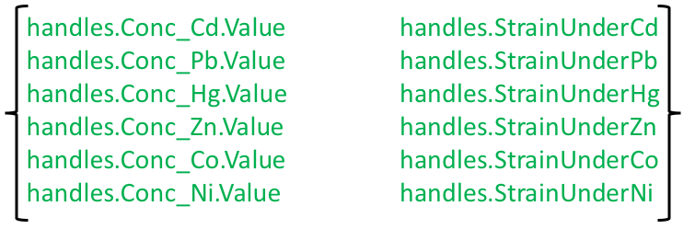
final_import
handles.output =
% --- Executes just before final_import is made visible.
uiwait(handles.final_import_Tag);
% --- Outputs from this function are returned to the command line.
varargout{1} = handles.output;
delete(handles.final_import_Tag); % close this GUI
% --- Executes on button press in Finish.
handles.output = { … }
guidata(hObject, handles);
uiresume(handles.final_import_Tag);

Slide 10
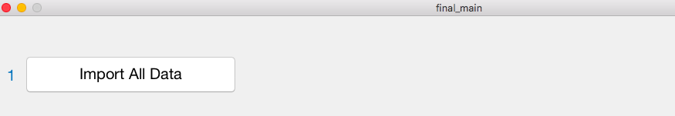
final_import
varargout{1} = handles.output;
final_main
OUTPUT = FUNCTION (INPUT)
handles.Data_from_final_import = final_import ( );

Slide 11
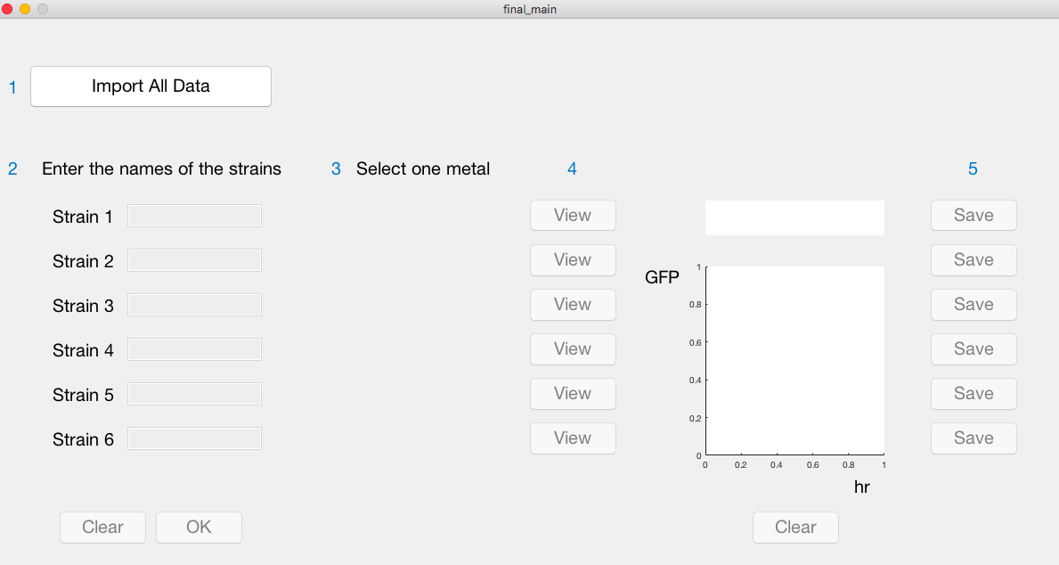
final_main

Slide 12
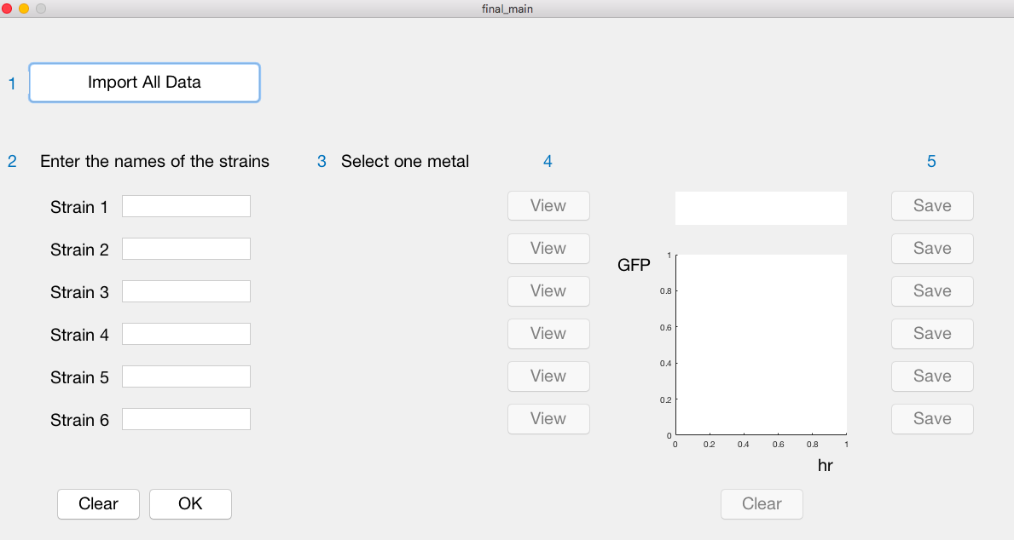
final_main

Slide 13

final_main
% [pushbutton] & [edit]
set( handles.Name_Strain1, 'Enable', 'off')
set( handles.Name_Strain1, 'Enable', 'on')
% [popupmenu]
set(handles.Metal_Strain1, 'Visible', 'off')
set(handles.Metal_Strain1, 'Visible', 'on')

Slide 14
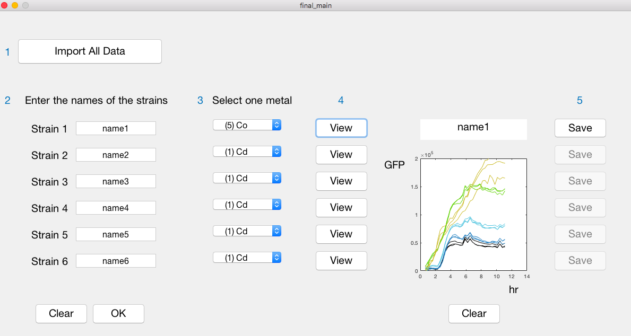
final_main

Slide 15
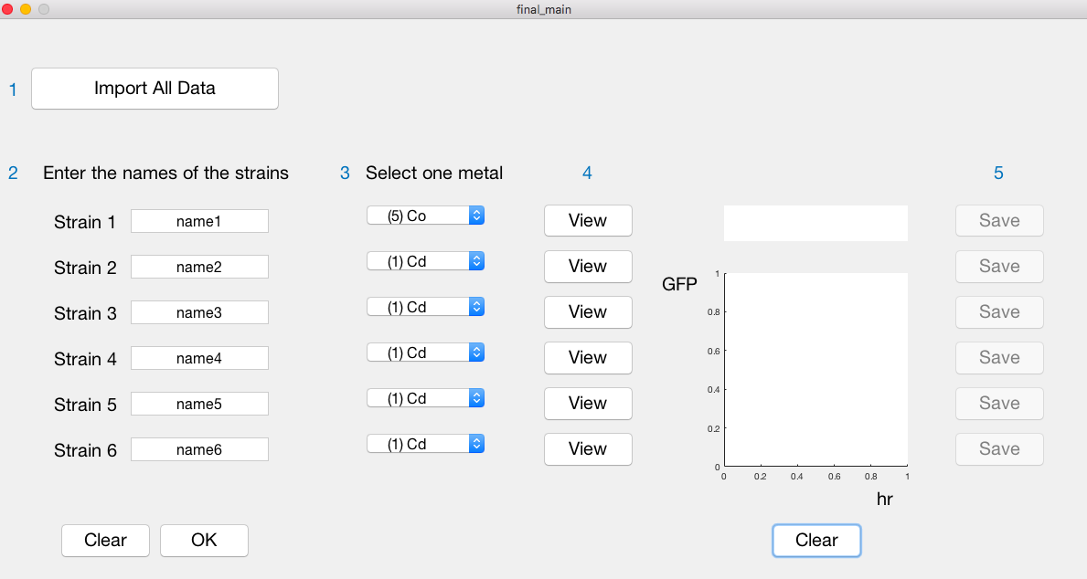
final_main

Slide 16
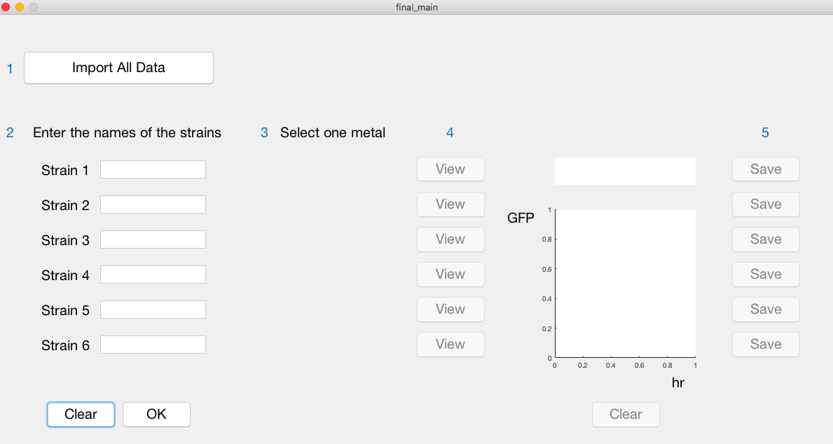
final_main

Slide 17
final_main

Slide 18
Thank you

